Slide 1
Introduction to AI 人工智慧簡介
J.-S. Roger Jang (張智星)
MIR Lab, CSIE Dept.
National Taiwan University
jang@mirlab.org, http://mirlab.org/jang

Slide 2
大綱 Outline
定義與歷史 Definition and history
分類與分支 Categories and branches
應用與里程碑 Applications and benchmarks
難題與衝突 Dilemmas and conflicts
結論 Conclusions

Slide 3
什麼是人工智慧？ What is AI?
What is AI (Artificial Intelligence)?
AI is the simulation of human intelligence processes by computers.
Elaine Rich and Kevin Knight: AI is the study of how to make computers do things at which, at the moment, people are better. ➔ 一旦電腦比人做得好的事，就不是AI!

Slide 4
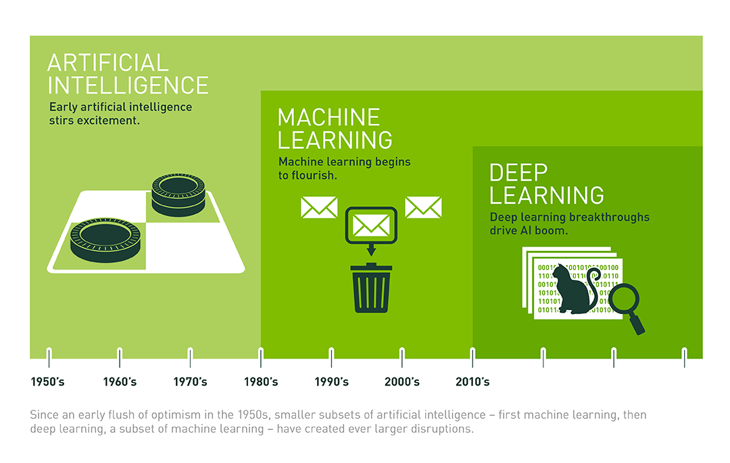
人工智慧 vs. 機器學習 vs. 深度學習 AI vs. Machine Learning vs. Deep Learning
AI ➔ ML ➔ DL
https://www.princeton.edu/news/2018/10/26/princeton-students-take-deep-dive-deep-learning-computing

Slide 5
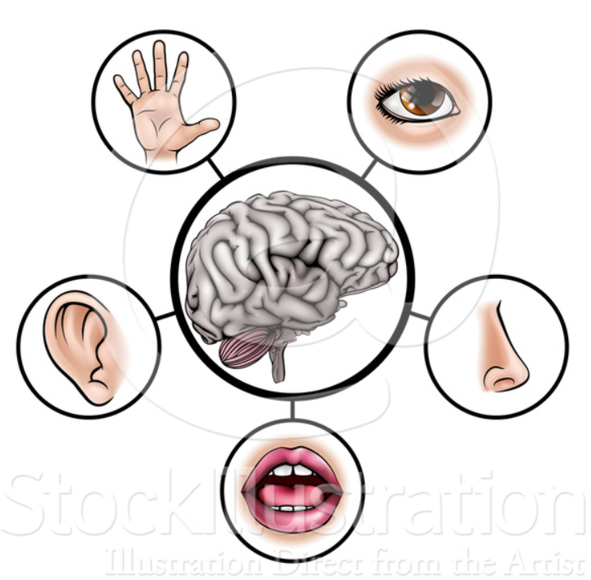
人類的智慧 Human Intelligence
Human intelligence 人類的智慧
Level 1: Perception based 第一層次：透過五感感知
Perception: Five senses
Level 2: Brain based 第二層次：大腦思維
Learning: Acquire and organize information
Reasoning: Use information and rules to reach conclusions
Self-correction: Correct rules if they failed
Example: Language learning 以語文學習為例
Receptive skills: Easier!
Read, listen
Productive skills: Harder!
Write, speak
Quiz!
Level-1
Leve-2

Slide 6
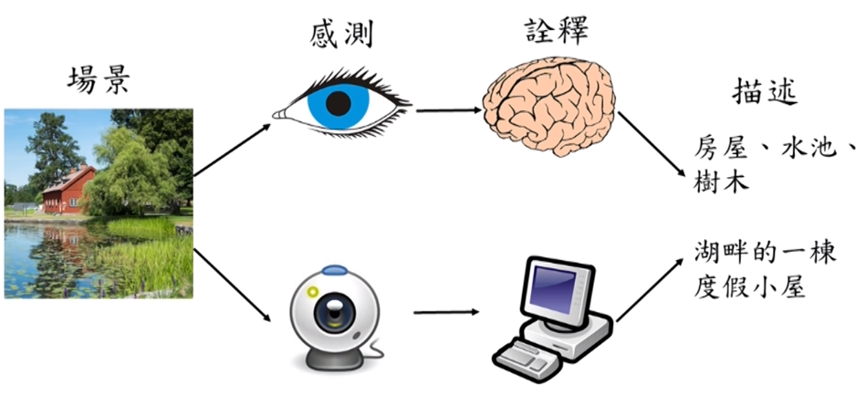
電腦視覺 Computer Vision
https://www.youtube.com/watch?v=7-Mk-VMM9F8&t=857s

Slide 7
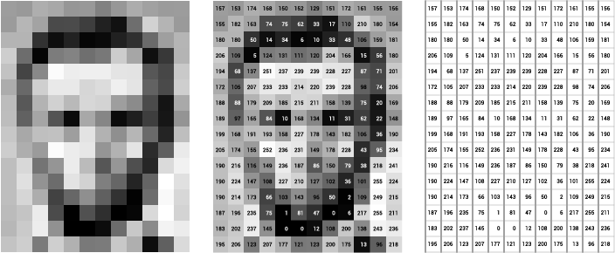
電腦視覺案例 Example of Computer Vision
What human sees:
Quiz!
What computers see:
https://openframeworks.cc/ofBook/chapters/image_processing_computer_vision.html

Slide 8
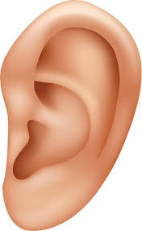
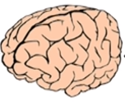
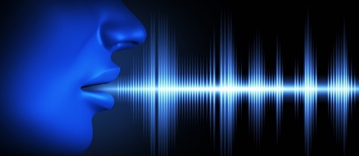
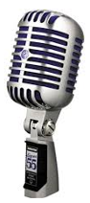


語音辨識 Speech Recognition
Sensors
Analysis
Outputs
Speech signals
Hello world!
Hello world!
Halo word!
Examples:
用心良苦 ➔ ???
It’s hard to recognize speech. ➔ ???
兩隻老虎
It’s hard to wreck a nice beach.

Slide 9
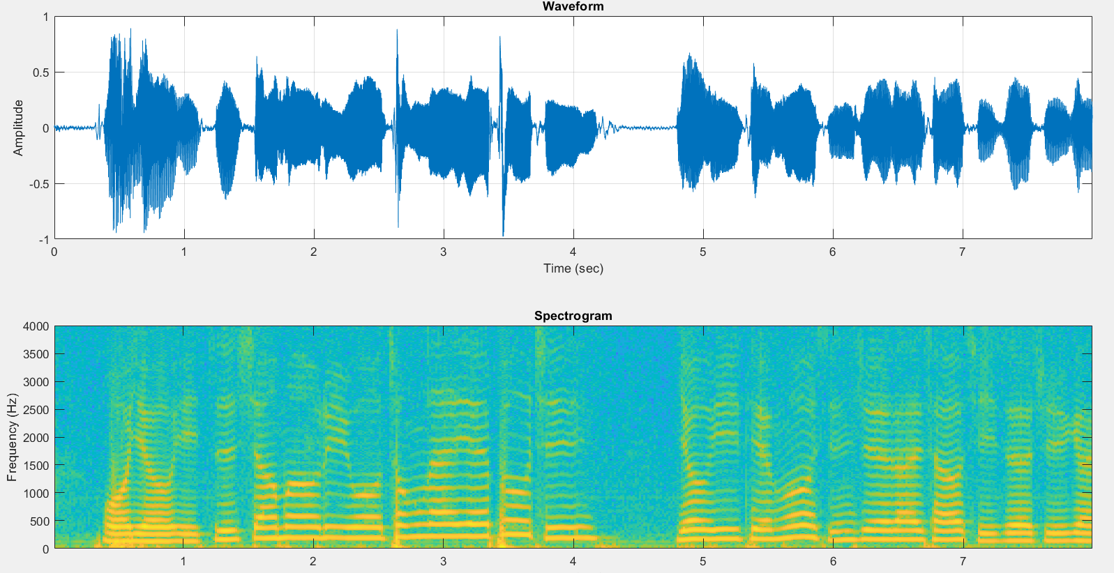

音訊處理範例 Example of Audio Processing

Slide 10
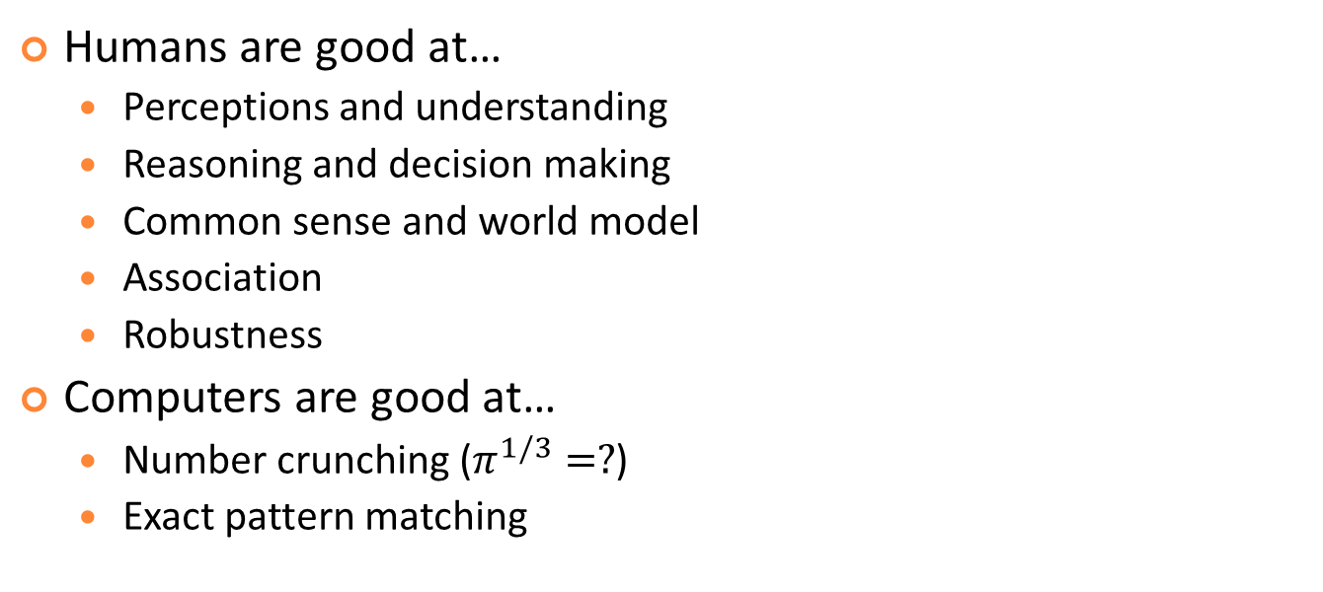
人類 vs. 電腦 Humans vs. Computers
Humans are good at…
Perceptions and understanding
Reasoning and decision making
Common sense and world model
Association
Robustness
Computers are good at…
Number crunching ($π^{1/3}=?$)
Exact pattern matching
The result of evolution
by natural selection!

Slide 11
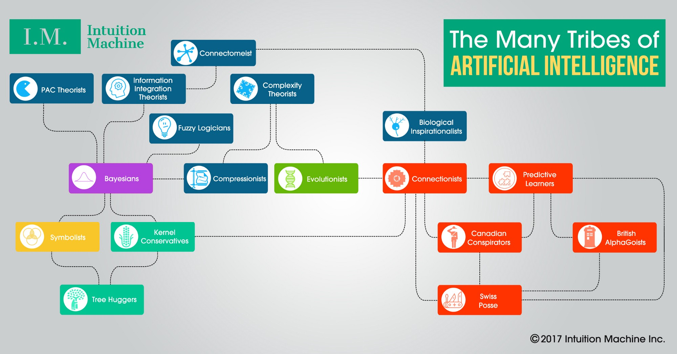
人工智慧眾多發展路徑 Many Tribes of AI
https://medium.com/intuitionmachine/the-many-tribes-problem-of-artificial-intelligence-ai-1300faba5b60

Slide 12
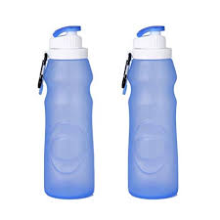
近似推理 ( 人工智慧分支) Approximate Reasoning (A Branch of AI)
Types of uncertainty
Probability ➔ 客觀的事實
Possibility ➔ 主觀的認定
Goal of approximate reasoning
Reasoning and aggregation of uncertainties
Example
Poisonous with a
probability of 0.2
Poisonous with a
possibility of 0.2

Slide 13
人工智慧與人類的工作流程比較 AI Workflow Compared to Human
Input: Perception
Text, speech, audio, images, video
CPU/brain: Decision making or reasoning
Rule induction
Uncertainty propagation
Theorem proving
Output
Summarization of texts
Chatbot
Text to speech synthesis
Rendering of multimedia

Slide 14
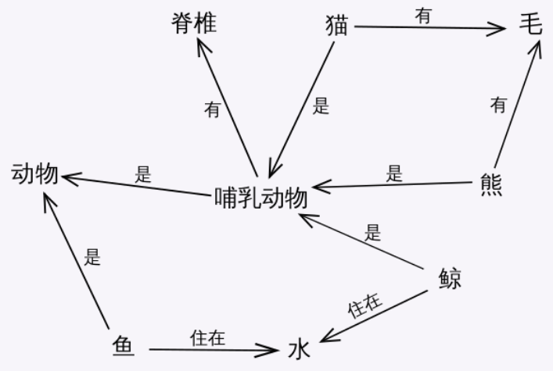
人工智慧的類型 Types of AI
Narrow AI
AI for a specific task
Broad AI
AI for a wide range of tasks
Requirement
World model and common sense reasoning

Slide 15
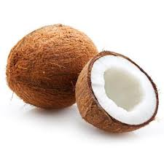

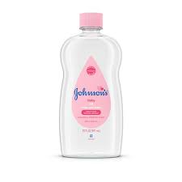
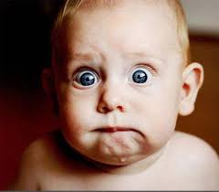
常識推理 Common Sense Reasoning
In a world model, how does a computer know common sense? How does it reasoning using common sense?
A pencil has a pointed end?
A girl usually has long hair?
Build the world model is difficulty since ambiguity is everywhere
Olive oil, coconut oil, baby oil?
Look at the dog with one eye.
Tone Sandhi (連續變調)
➔
➔

Slide 16
機器學習的範疇 Areas of Machine Learning
Classification: Assign a category to a given object
Determine if it will rain tomorrow
Regression: Predict a real-value for a given object
Predict the exchange rate
Ranking: Order objects according to some criterion
Rank the webpages returned by a search engine
Clustering: Partition data into homogeneous groups
Dimensionality reduction: Find low-dimensional manifold preserving some properties of the data
Density estimation: Learning probability density function according to sample data

Slide 17
建模概念 Concept of Modeling
Given desired i/o pairs (training set) of the form (x₁, ..., x_{n}; y), construct a model to match the i/o pairs
Two steps in modeling
structure identification: input selection, model complexity
parameter identification: optimal parameters
x₁
Unknown target system
y
. . .
x_{n}
Model f()
y*
Notes:
Given an input condition, it very easy to derive the overall output. However, our task is more than that. What we want to do is to construct an appropriate fuzzy inference system that can match a desired input/output data set of a unknown target system. This is called fuzzy modeling and it a branch of nonlinear system identification. In general, fuzzy modeling involves two step. The first step is structure identification, where we have to find suitable numbers of fuzzy rules and membership functions. In FLT, this is accomplished by subtractive clustering proposed by Steve Chiu in Rockwell Science Research Center. The second step is parameter identification, where we have to find the optimal parameters for membership functions as well as output linear equations. In the FLT, this is done by ANFIS, which was proposed by me back in 1991. Since ANFIS uses some neural network training techniques, it is also classified as one of the neuro-fuzzy modeling approaches.

Slide 18
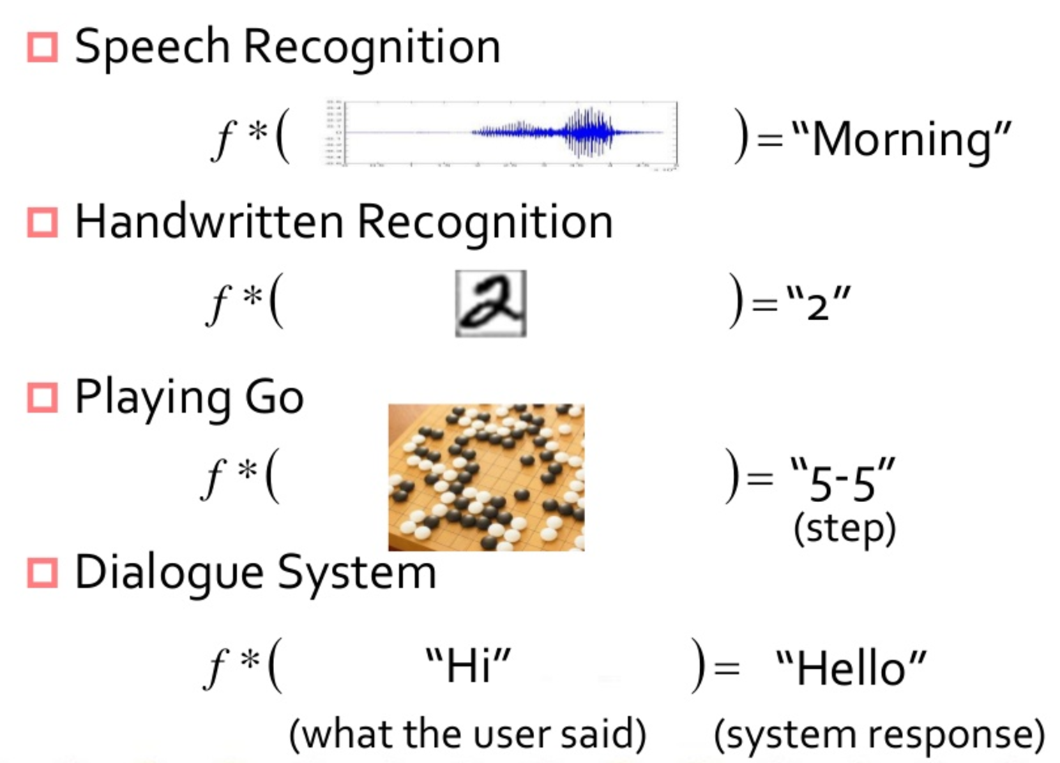
機器學習的範例 Example of Machine Learning (or Modeling)
https://www.slideshare.net/tw_dsconf/ss-70083878

Slide 19
人工智慧里程碑 AI Benchmark Events
1950: Alan Turing published “Computing Machinery and Intelligence” and proposed a test which is later known as the Turing Test.
1956: “Artificial Intelligence” was first coined by John McCarthy at the Dartmouth Conference.
1960: “Joseph Weizenbaum” creates the first chatbot, Eliza.
1969: Minsky’s pessimistic remark about single layer perceptron
1974-1980: First AI winter
1980: The first AAAI conference
1986: Reinvention of backpropagation
1990-1996: Second AI winter
1997: IBM Deep Blue beats world chess champion
2002: AI enters the home in the form of Roomba
2011: IBM Watson beats Ken Jennings, a Jeopardy star
2017: Google’s AlphaGo beats top players in Go

Slide 20
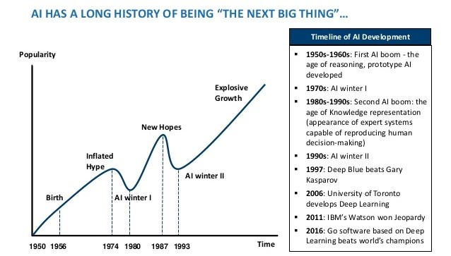
人工智慧研究的起落 Boom and Bust Cycles of AI Research
https://www.actuaries.digital/2018/09/05/history-of-ai-winters/

Slide 21
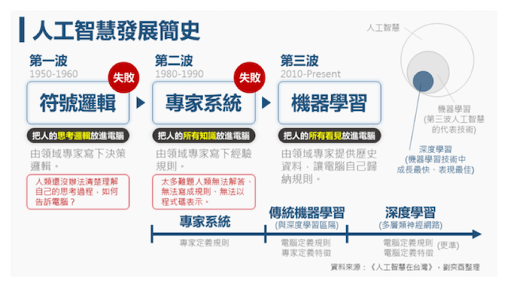
人工智慧的三波浪潮與三波重點
https://futurecity.cw.com.tw/article/743

Slide 22
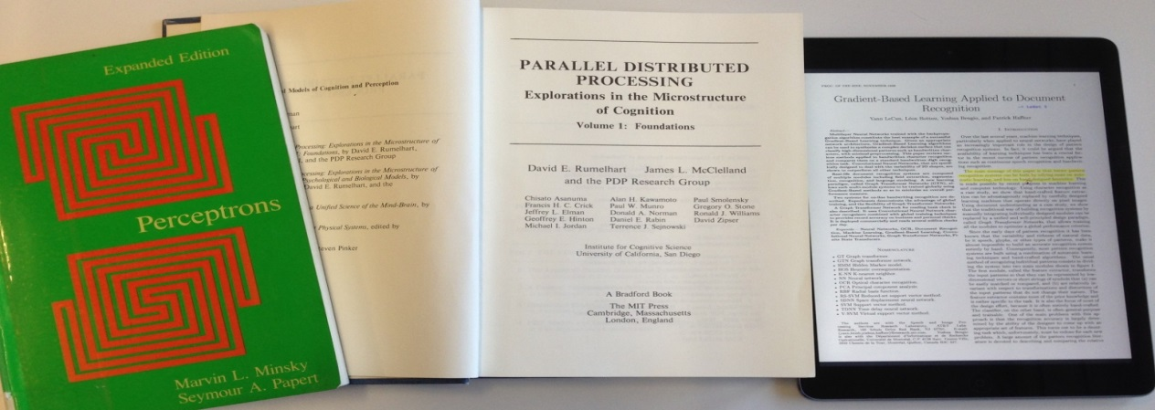
具代表性的論文 Representative Publications
Three famous NN publications
Minsky’s “Perceptrons”
Rumelhart’s “Parallel Distributed Processing”
LeCun’s “Gradient-based Learning Applied to Document Recognition”.

Slide 23
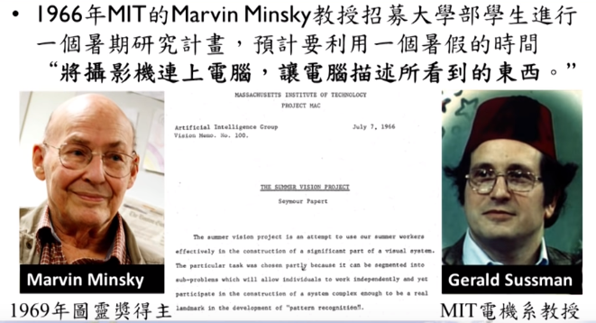
從1966年持續至今的研究 An Unfinished Summer Project
https://www.youtube.com/watch?v=7-Mk-VMM9F8&t=1146s

Slide 24
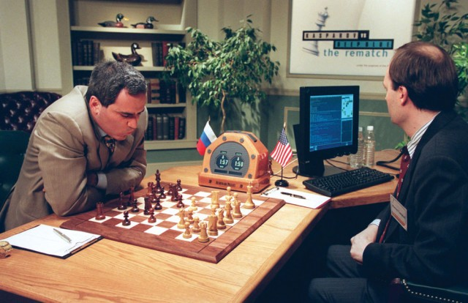
1997
IBM Deep Blue beats world chess champion

Slide 25
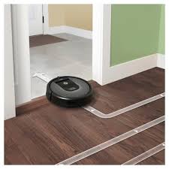
2002
AI enters the home in the form of Roomba

Slide 26
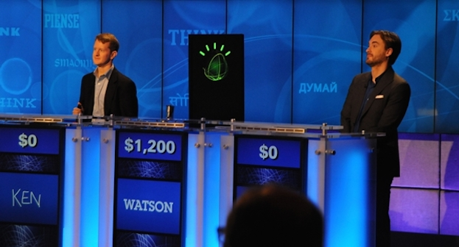
2011
IBM Watson beats Ken Jennings, a Jeopardy star

Slide 27
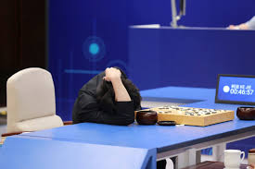
2017
AlphaGo vanquishes world’s top Go player, marking AI’s superiority over human mind

Slide 28
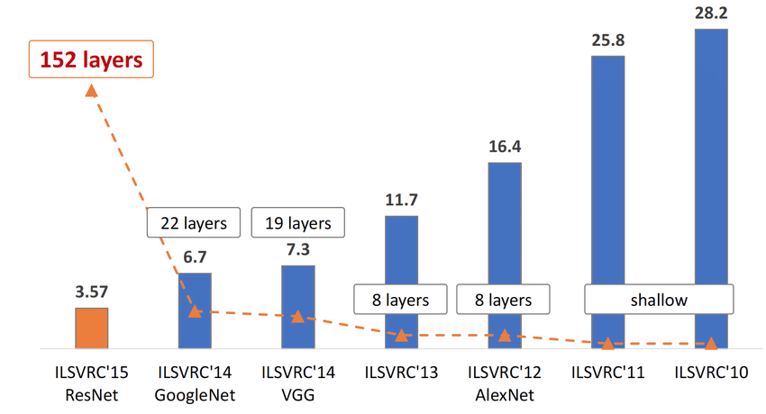
ImageNet Competition 影像辨識大賽
The evolution of the winning entries on the ImageNet Large Scale Visual Recognition Challenge from 2010 to 2015
Human: 5%!
https://www.researchgate.net/figure/The-evolution-of-the-winning-entries-on-the-ImageNet-Large-Scale-Visual-Recognition_fig1_321896881

Slide 29
AI Application Domains and Missing Professions
Quiz!
AI應用的四大領域 (余孝先, 2019)
財務金融
醫療照護
零售業
製造業
消失的四個師 (李開復, 2016)
財務分析師（理財專員）
醫師
律師
教師
https://www.youtube.com/watch?v=qNnANX1unxM
https://www.cw.com.tw/article/article.action?id=5075945
其他可能：會計師、駕駛員

Slide 30
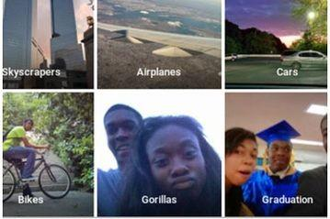
人工智慧的難題：對種族與膚色的偏見 AI Dilemma: Race/Color Discrimination?
2015 年 7 月，谷歌旗下照片應用 Google Photo 把兩名黑人「誤認」成了大猩猩引發了熱議，隨後谷歌連忙致歉，並表示正在改進算法以解決這一問題。
https://kknews.cc/tech/pxgnaqp.html

Slide 31
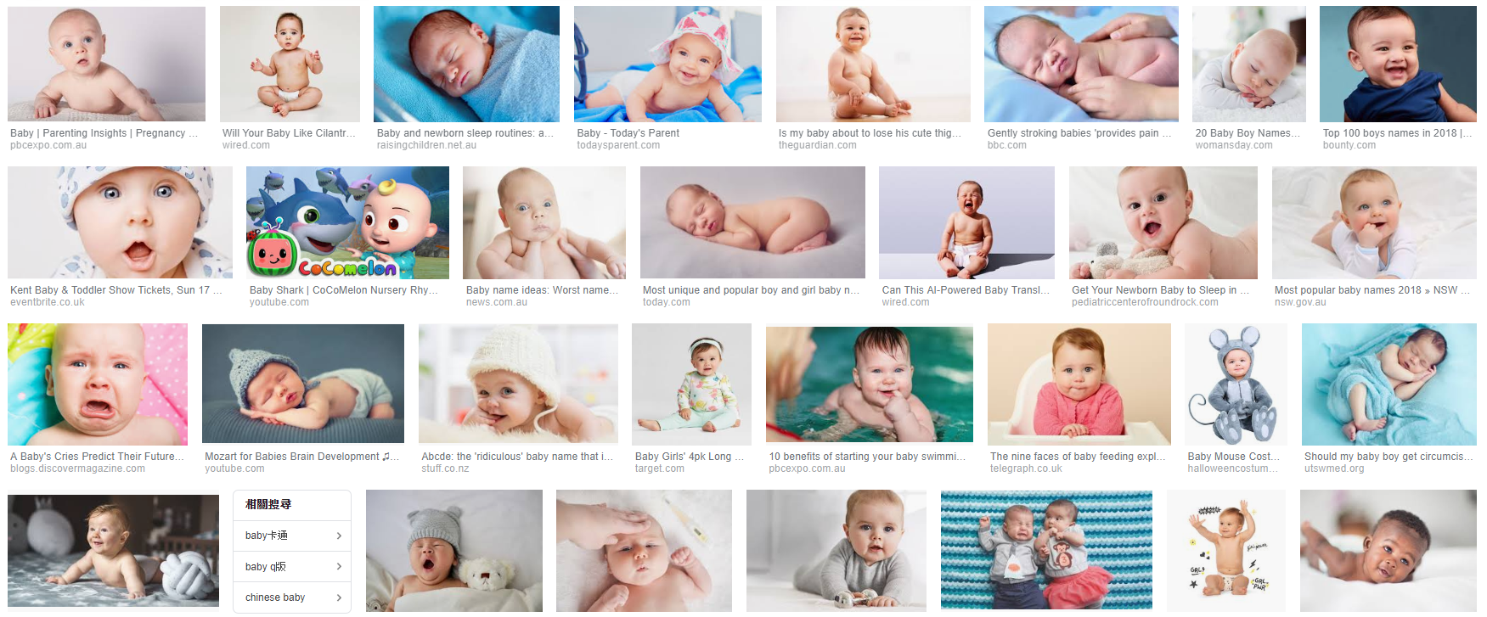
人工智慧的難題：對種族與膚色的偏見 AI Dilemma: Race/Color Bias
2015年，Johanna Burai在谷歌上搜索「手」的圖片，發現谷歌搜索最前面的結果只有白皮膚的手。隨後，她發起了「全球白網」（World White Web）計劃。
https://kknews.cc/tech/oyjkejq.html
Result of search for “baby” over Google

Slide 32
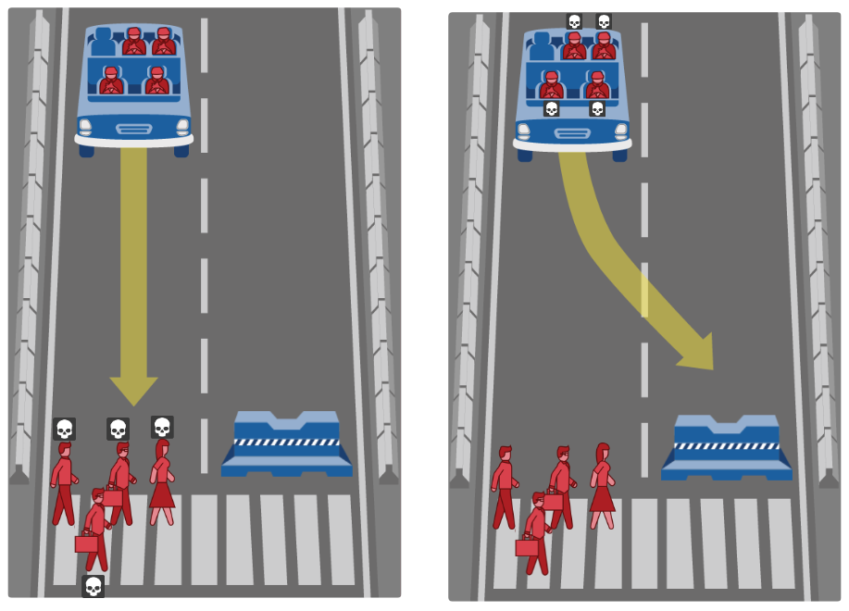
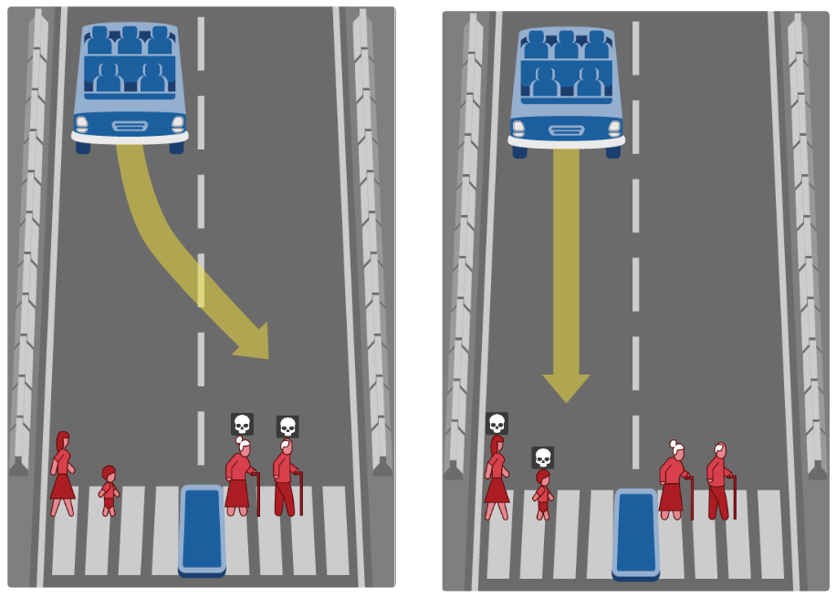
人工智慧的兩難：倫理與道德 (1/2) AI Dilemma: Ethnics & Morality
What should the self-driving car do?
Save you or others?
Judge people (to kill) by what?
http://moralmachine.mit.edu

Slide 33
人工智慧的兩難：倫理與道德 (2/2) AI Dilemma: Ethnics & Morality
想看看…
如果你是軟體設計者，你的決策標準是？
如果你是自駕車商，你要如何說明這輛車的決策？
如果你是立法諸公，你要如何規範處理至些情況？

Slide 34
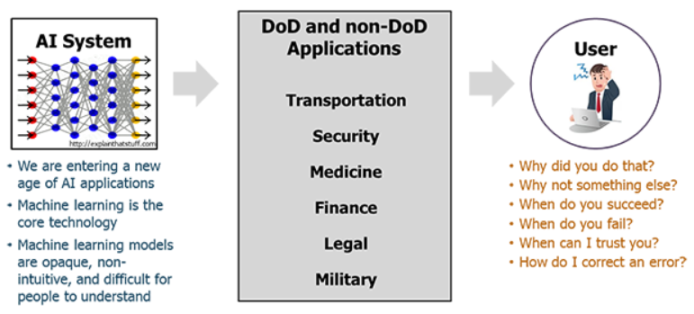
人工智慧難題: 可被解讀與信任嗎？ AI Dilemma: Explainability and Trustability
This is especially important for
Precision medicine, healthcare analytics, financial applications
XAI (explainable AI) is becoming important
DARPA’s 15-year XAI project
Workshop on XAI at IJCAI-2017
https://www.darpa.mil/program/explainable-artificial-intelligence

Slide 35
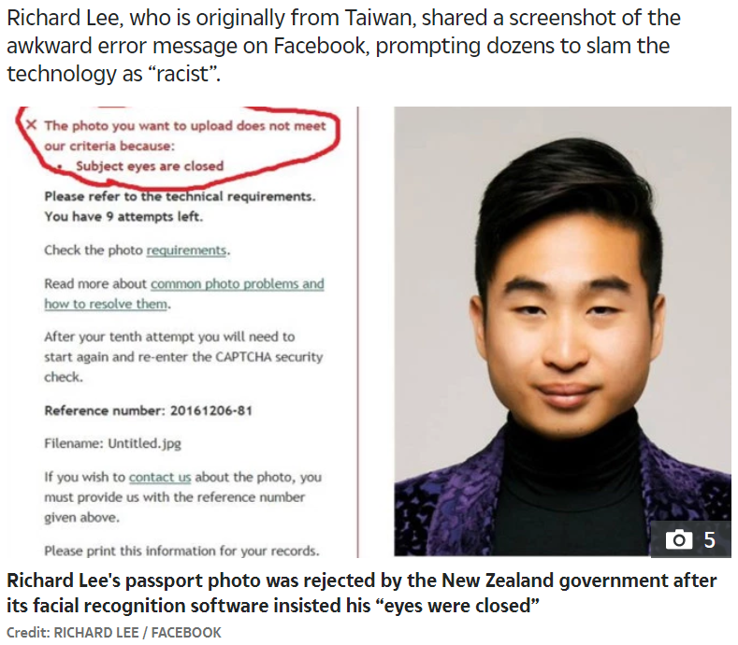
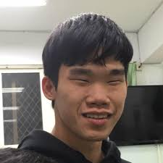
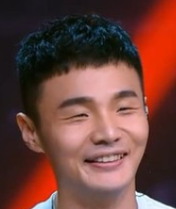
人工智慧難題: 無心的錯誤 AI Dilemma: Innocent Mistake
https://edition.cnn.com/2016/12/07/asia/new-zealand-passport-robot-asian-trnd/index.html

Slide 36


偽造的聲音、圖片與影片
DeepNude
濫用AI技術偽造女性裸照 打擊復仇式色情「DeepNude」在美遭下架 (2019/06/30)
實測人工智能「脫衣」軟件DeepNude，真的那麼強大嗎？ (2019/07/03)
DeepFake

Slide 37
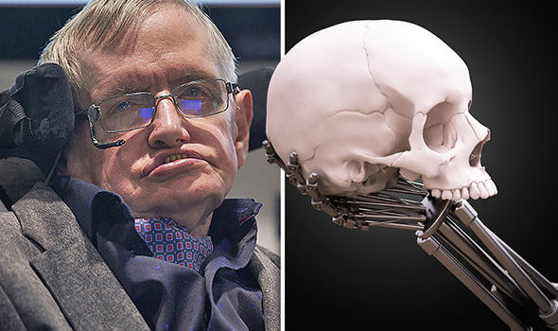
人工智慧將摧毀人類嗎？ How AI Destroys Human?
Humanity’s days are NUMBERED and AI will cause mass extinction, warns Stephen Hawking (2017/11/03)

Slide 38
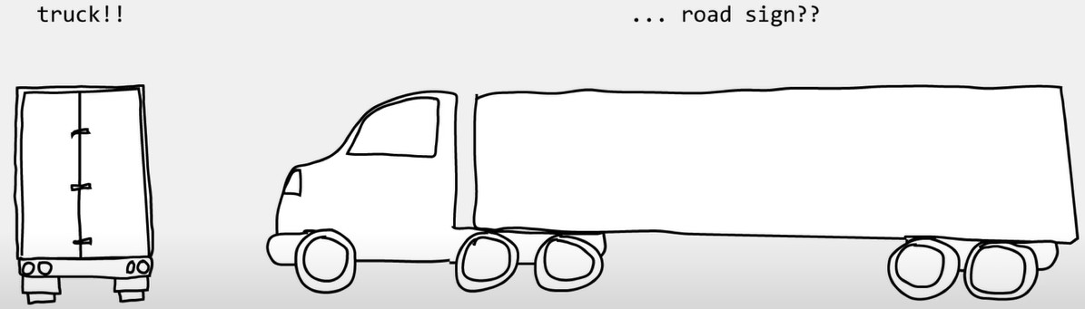
Mistakes by AI/ML: Biased Data
Tesla accident
Source

Slide 39
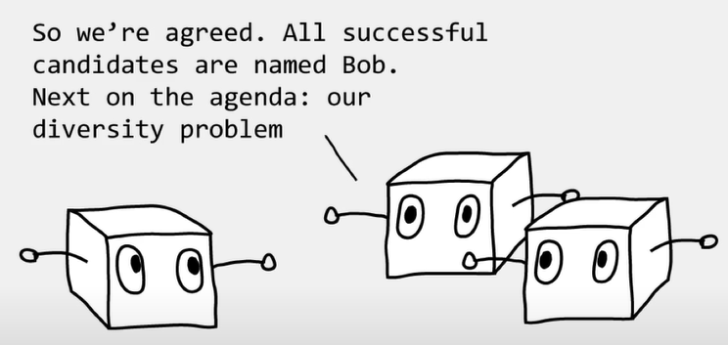
Mistakes by AI/ML: Biased Data
Amazon HR
Source

Slide 40
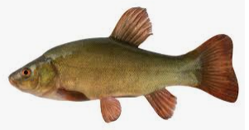
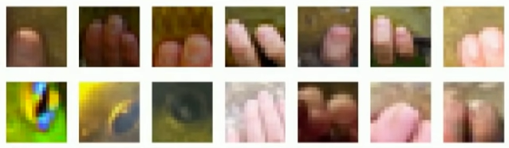
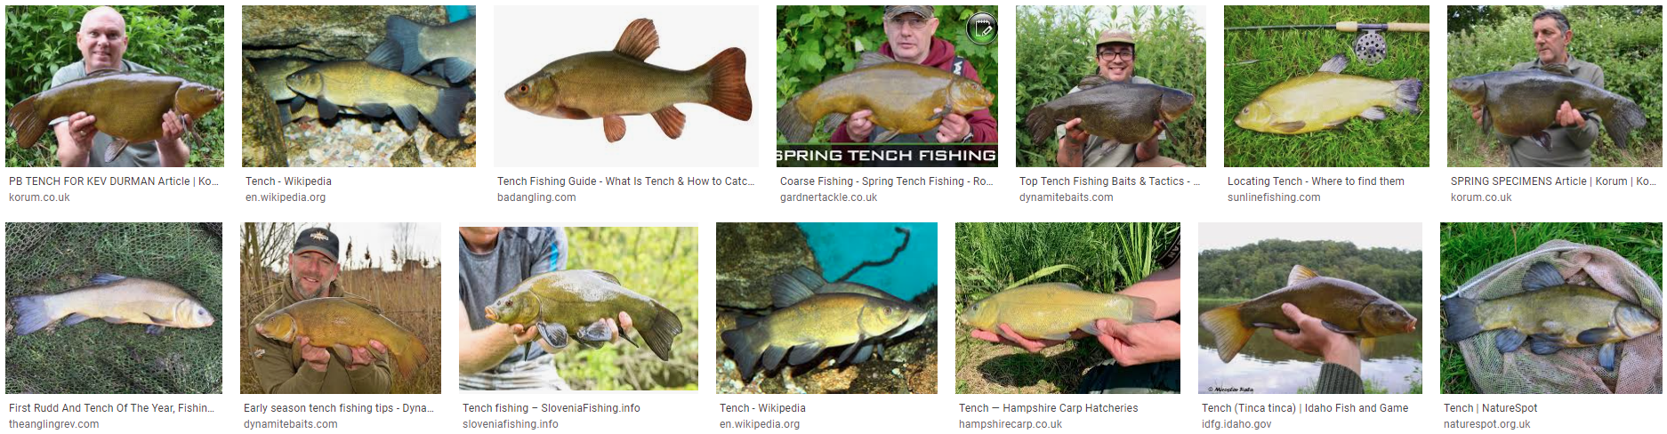
Mistakes by AI/ML: Biased Data
Highlighted part of Tench
Tench
丁鱥
When you google “tench”…

Slide 41
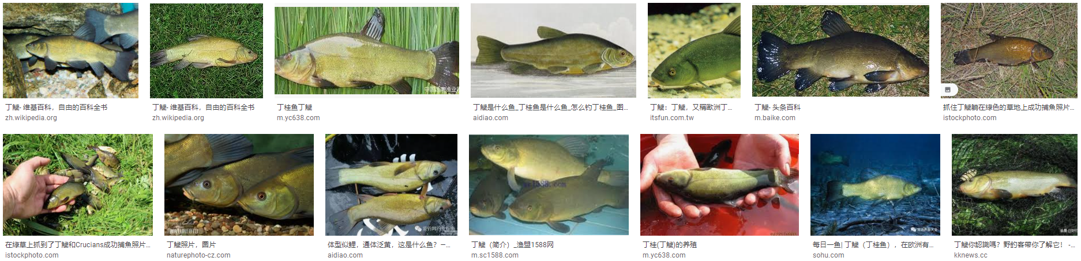
Mistakes by AI/ML: Biased Data
Tench
丁鱥
When you google “丁鱥”…

Slide 42
人工智慧服務與工具 AI Services and Tools
AI as a Service (AIaaS)
Google AI
Microsoft Cognitive Services
IBM Watson Assistant
Amazon AI
Tools
Python, R, JavaScript, …
MATLAB, SAS, IBM, …

Slide 43
結論 Conclusions
2018台灣產業AI成熟度: 金融業較高、但尚有6成企業未導入AI (link)
Is AI for real this time?
Definitely yes!
How will AI expand?
Extensively! (Analogy: Internet era starting 1994)
AI is not everything, but without AI, you are nothing!
Are you AI-ready?

